Slide 1
PHP FRAMEWORK LARAVEL

Slide 2
PHP Frameworks
A PHP Framework is a basic platform that allows us to develop web applications. PHP Framework, helps for stopping the need to produce repetitive code, and you’ll be able to build applications rapidly (RAD). Without a PHP Framework in place, it gets much more difficult to produce applications since you’ll have to repeatedly code a lot of PHP.

Slide 3
PHP operates on the Model View Controller (MVC) fundamentals.
Model View Controller or MVC as it is popularly called, is a software design pattern for developing web applications. A Model View Controller pattern is made up of the following three parts −
Model − The lowest level of the pattern which is responsible for maintaining data.
View − This is responsible for displaying all or a portion of the data to the user.
Controller − Software Code that controls the interactions between the Model and View.

Slide 4
What to Look for When Choosing Your Frameworks?
a) Database Support
Database support is very important. For example, CodeIgniter framework supports MySQL, Oracle, and SQLite, while the Kohana framework doesn’t support Oracle or SQLite. Depending on which database you prefer to use or choose for your project at hand.
b) Community Support
Your framework should have a strong community, not just in terms of size but also in activity and helpfulness. Even if it’s a small community, as long as you’re able to find support, then that’s a plus point.
c) Documentation Support
You should also be tired of frameworks that don’t have any documentation and absolutely no user guide. Make sure that your PHP Framework has good documentation that’s kept up-to-date, and that the user guide its relatively easy to follow.

Slide 5
PHP framework:
Laravel
Symfony

Slide 6
Laravel
Laravel is an open-source web MVC framework for PHP. Laravel is a robust framework that provides easy development of PHP web applications with features like a modular packaging system with a dedicated dependency manager, access to relational databases, and other utilities for application deployment and maintenance.
Laravel was created by Taylor Otwell. Since its initial release in June 2011 (version 1).

Slide 7
Advantages of Laravel
Laravel offers you the following advantages, when you are designing a web application based on it −
The web application becomes more scalable, owing to the Laravel framework.
Considerable time is saved in designing the web application, since Laravel reuses the components from other framework in developing web application.
It includes namespaces and interfaces, thus helps to organize and manage resources.

Slide 8
Composer
Composer is a tool which includes all the dependencies and libraries. It allows a user to create a project with respect to the mentioned framework (for example, those used in Laravel installation). Third party libraries can be installed easily with help of composer.
All the dependencies are noted in composer.json file which is placed in the source folder.

Slide 9
Artisan
Command line interface used in Laravel is called Artisan. It includes a set of commands which assists in building a web application. These commands are incorporated from Symphony framework, resulting in add-on features in Laravel 5.1 (latest version of Laravel).

Slide 10
Features of Laravel
Laravel offers the following key features which makes it an ideal choice for designing web applications −
Modularity:
Laravel provides 20 built in libraries and modules which helps in enhancement of the application. Every module is integrated with Composer dependency manager which eases updates.
Testability:
Laravel helps in testing through various test cases. This feature helps in maintaining the code as per the requirements.

Slide 11
Routing
Laravel provides a flexible approach to the user to define routes in the web application. Routing helps to scale the application in a better way and increases its performance.
Configuration Management
A web application designed in Laravel will be running on different environments. Laravel provides a consistent approach to handle the configuration in an efficient way.
Query Builder and ORM
Laravel incorporates a query builder which helps in querying databases using various simple methods. It provides ORM (Object Relational Mapper) and ActiveRecord implementation called Eloquent.

Slide 12
Schema Builder
Schema Builder maintains the database definitions and schema in PHP code.
Template Engine
Laravel uses the Blade Template engine, a lightweight template language used to design hierarchical blocks and layouts that include dynamic content.
E-mail
Laravel includes a mail class which helps in sending mail with rich content and attachments from the web application.
Authentication
User authentication is a common feature in web applications. Laravel eases designing authentication as it includes features such as register, forgot password.

Slide 13
Redis
Laravel uses Redis to connect to an existing session. Redis interacts with session directly.
Queues
Laravel includes queue services like emailing large number of users. These queues help in completing tasks in an easier manner without waiting for the previous task to be completed.
Event and Command Bus
Laravel includes Command Bus which helps in executing commands and dispatch events in a simple way.

Slide 14
Laravel - Installation
For managing dependencies, Laravel uses composer. Make sure you have a Composer installed on your system before you install Laravel.
You will have to follow the steps given below for installing Laravel onto your system −
Step 1 − Visit the following URL and download composer to install it on your system.
https://getcomposer.org/download/
Step 2 − After the Composer is installed, check the installation by typing the Composer command in the command prompt as shown in the following screenshot.

Slide 15
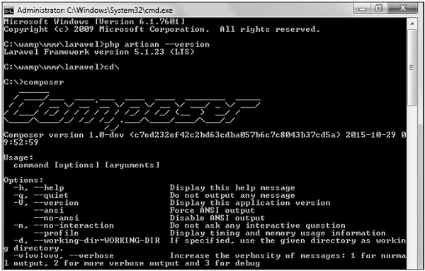

Slide 16
Step 3 − Create a new directory anywhere in your system for your new Laravel project. After that, move to path where you have created the new directory and type the following command there to install Laravel.
  composer create-project laravel/laravel –-prefer-dist
Now, we will focus on installation of version 5.7. In Laravel version 5.7, you can install the complete framework by typing the following command −
composer create-project laravel/laravel test dev-develop
The output of the command is as shown below −

Slide 17
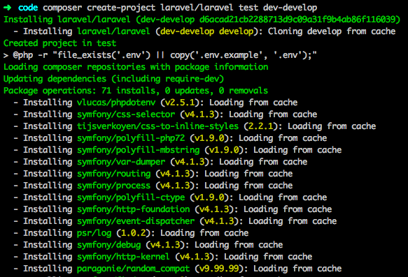

Slide 18
The Laravel framework can be directly installed with develop branch which includes the latest framework.
Step 4 − The above command will install Laravel in the current directory. Start the Laravel service by executing the following command.
php artisan serve
Step 5 − After executing the above command, you will see a screen as shown below −

Slide 19
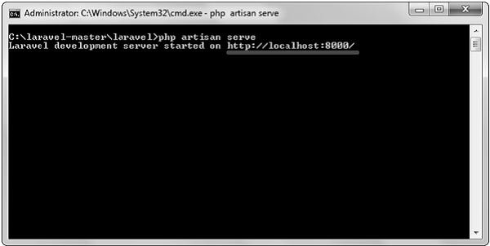

Slide 20
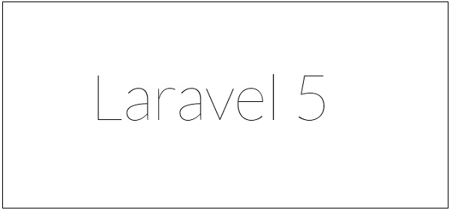
Step 6 − Copy the URL underlined in gray in the above screenshot and open that URL in the browser. If you see the following screen, it implies Laravel has been installed successfully.

Slide 21
Laravel - Configuration
configuration files of Laravel are included in the config directory

Slide 22
Maintenance
Maintenance Mode
Sometimes you may need to update some configuration values or perform maintenance on your website. In such cases, keeping it in maintenance mode, makes it easier for you. Such web applications which are kept in maintenance mode, throw an exception namely MaintenanceModeException with a status code of 503.
You can enable the maintenance mode on your Laravel web application using the following command −
php artisan down

Slide 23
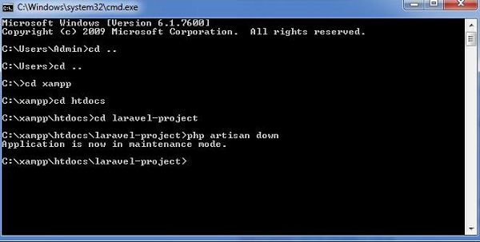

Slide 24
Once you finish working on updates and other maintenance, you can disable the maintenance mode on your web application using following command −
php artisan up p

Slide 25
Laravel - Routing
In Laravel, all requests are mapped with the help of routes. Basic routing routes the request to the associated controllers.
Routing in Laravel includes the following categories −
Basic Routing
Route parameters
Named Routes

Slide 26
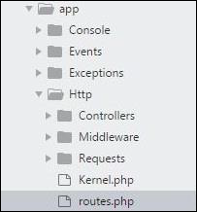
1. Basic Routing
All the application routes are registered within the app/routes.php file. This file tells Laravel for the URIs it should respond to and the associated controller will give it a particular call. The sample route for the welcome page can be seen as shown in the screenshot given below −

Slide 27
Route::get ('/', function ()
{
return view('welcome');
}
);

Slide 28
Example
Observe the following example to understand more about Routing −
app/Http/routes.php or web.php
<?phpRoute::get('/', function () {
return view('welcome');
});

Slide 29
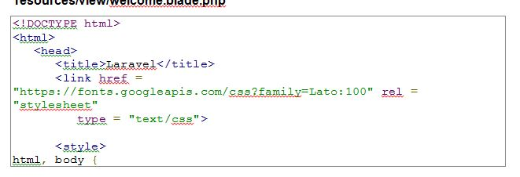
resources/view/welcome.blade.php

Slide 30
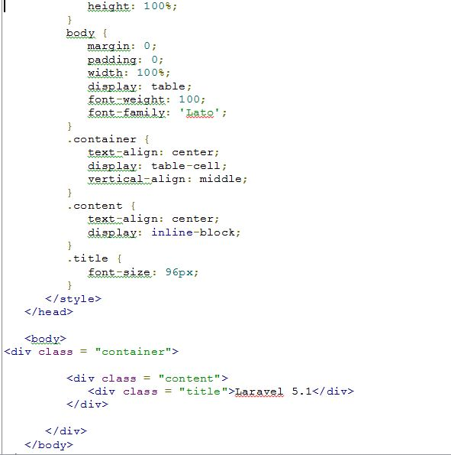

Slide 31
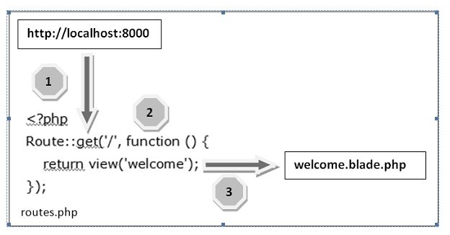

Slide 32
Let us now understand the steps involved in routing mechanism in detail −
Step 1 − Initially, we should execute the root URL of the application.
Step 2 − Now, the executed URL should match with the appropriate method in the route.php file. In the present case, it should match the method and the root (‘/’) URL. This will execute the related function.
Step 3 − The function calls the template file resources/views/welcome.blade.php. Next, the function calls the view() function with argument ‘welcome’ without using the blade.php.
This will produce the HTML output as shown in the image below −

Slide 33


Slide 34
2. Route Parameters
Sometimes in the web application, you may need to capture the parameters passed with the URL. For this, you should modify the code in routes.php file.
You can capture the parameters in routes.php/web.php file in two ways as discussed here −
Required Parameters
These parameters are those which should be mandatorily captured for routing the web application. For example, it is important to capture the user’s identification number from the URL. This can be possible by defining route parameters as shown below −
Route::get('ID/{id}',function($id) {
echo 'ID: '.$id;
});

Slide 35
Optional Parameters
Sometimes developers can produce parameters as optional and it is possible with the inclusion of ? after the parameter name in URL. It is important to keep the default value mentioned as a parameter name. Look at the following example that shows how to define an optional parameter −
Route::get('user/{name?}', function ($name = 'TutorialsPoint') {
return $name;
}
The example above checks if the value matches to TutorialsPoint and accordingly routes to the defined URL.

Slide 36
3. Named Routes
Named routes allow a convenient way of creating routes. The chaining of routes can be specified using name method onto the route definition. The following code shows an example for creating named routes with controller −
Route::get('user/profile', 'UserController@showProfile')->name('profile');
The user controller will call for the function showProfile with parameter as profile. The parameters use name method onto the route definition.

Slide 37
Laravel - Controllers
In the MVC framework, the letter ‘C’ stands for Controller. It acts as a directing traffic between Views and Models
Creating a Controller
Open the command prompt or terminal based on the operating system you are using and type the following command to create controller using the Artisan CLI (Command Line Interface).
php artisan make:controller <controller-name> --plain Replace the <controller-name> with the name of your controller. This will create a plain constructor as we are passing the argument — plain. If you don’t want to create a plain constructor, you can simply ignore the argument. The created constructor can be seen at app/Http/Controllers.
You will see that some basic coding has already been done for you and you can add your custom coding. The created controller can be called from routes.php by the following syntax.
Syntax
Route::get(‘base URI’,’controller@method’);

Slide 38
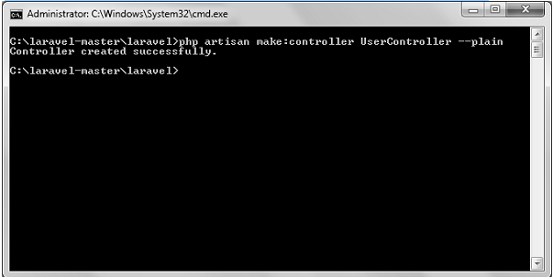
Example
Step 1 − Execute the following command to create UserController.
php artisan make:controller UserController --plainStep 2 − After successful execution, you will receive the following output.

Slide 39
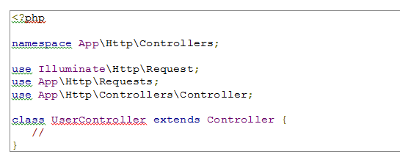
Step 3 − You can see the created controller at app/Http/Controller/UserController.php with some basic coding already written for you and you can add your own coding based on your need.

Slide 40
Laravel - Views
In MVC framework, the letter “V” stands for Views. It separates the application logic and the presentation logic. Views are stored in resources/views directory. Generally, the view contains the HTML which will be served by the application.
Example
Observe the following example to understand more about Views −
Step 1 − Copy the following code and save it at resources/views/test.blade.php
<html>
<body> <h1>Hello, World</h1>
</body> </html>

Slide 41
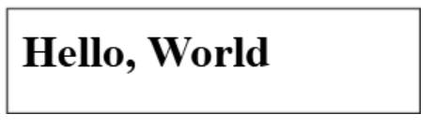
Step 2 − Add the following line in app/Http/routes.php file to set the route for the above view.
app/Http/routes.php
Route::get('/test', function() {
return view('test');
});
Step 3 − Visit the following URL to see the output of the view.
http://localhost:8000/test Step 4 − The output will appear as shown in the following image.

Slide 42
Passing Data to Views
While building application it may be required to pass data to the views. Pass an array to view helper function. After passing an array, we can use the key to get the value of that key in the HTML file.
Example
Observe the following example to understand more about passing data to views −
Step 1 − Copy the following code and save it at resources/views/test.php
<html>
<body>
<h1><?php echo $name; ?></h1>
</body>
</html>

Slide 43
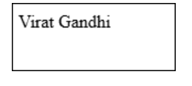
Step 2 − Add the following line in app/Http/routes.php file to set the route for the above view.
app/Http/routes.php
Route::get('/test', function() {
return view('test',[‘name’=>’Virat Gandhi’]);
});
Step 3 − The value of the key name will be passed to test.php file and $name will be replaced by that value.
Step 4 − Visit the following URL to see the output of the view.
http://localhost:8000/test Step 5 − The output will appear as shown in the following image.

Slide 44
Sharing Data with all Views
We have seen how we can pass data to views but at times, there is a need to pass data to all the views. Laravel makes this simpler. There is a method called share() which can be used for this purpose. The share() method will take two arguments, key and value. Typically share() method can be called from boot method of service provider. We can use any service provider, AppServiceProvider or our own service provider.
Example
Observe the following example to understand more about sharing data with all views −

Slide 45
Step 1 − Add the following line in app/Http/routes.php file.
app/Http/routes.php
Route::get('/test', function() {
return view('test');
});
Route::get('/test2', function() {
return view('test2');
});

Slide 46
Step 2 − Create two view files — test.php and test2.php with the same code. These are the two files which will share data. Copy the following code in both the files. resources/views/test.php & resources/views/test2.php
<html>
<body>
<h1><?php echo $name; ?></h1>
</body>
</html>

Slide 47
Step 3 − Change the code of boot method in the file app/Providers/AppServiceProvider.php as shown below. (Here, we have used share method and the data that we have passed will be shared with all the views.) app/Providers/AppServiceProvider.php

Slide 48
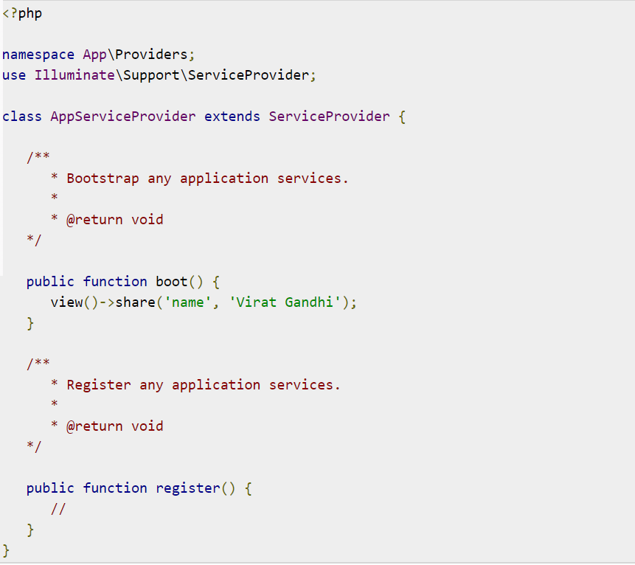

Slide 49
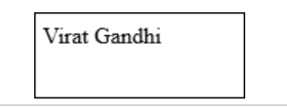
Step 4 − Visit the following URLs.
http://localhost:8000/test http://localhost:8000/test2
Step 5 − The output will appear as shown in the following image.

Slide 50
Laravel - Request
Retrieving the Request URI
The “path” method is used to retrieve the requested URI. The is method is used to retrieve the requested URI which matches the particular pattern specified in the argument of the method. To get the full URL, we can use the url method.
Example
Step 1 − Execute the below command to create a new controller called UriController.
php artisan make:controller UriController –plain
Step 2 − After successful execution of the URL, you will receive the following output −

Slide 51
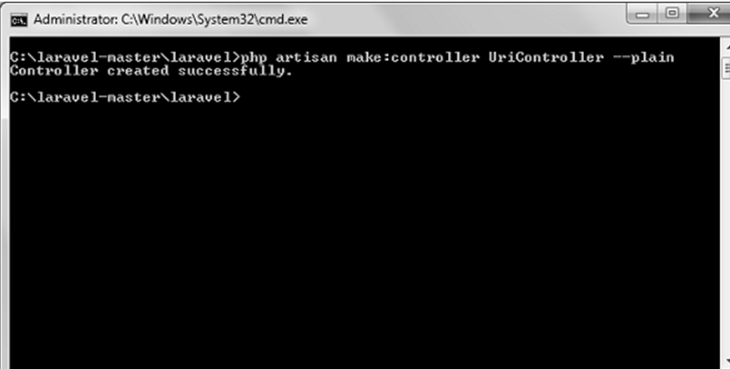

Slide 52
Step 3 − After creating a controller, add the following code in that file.
app/Http/Controllers/UriController.php

Slide 53
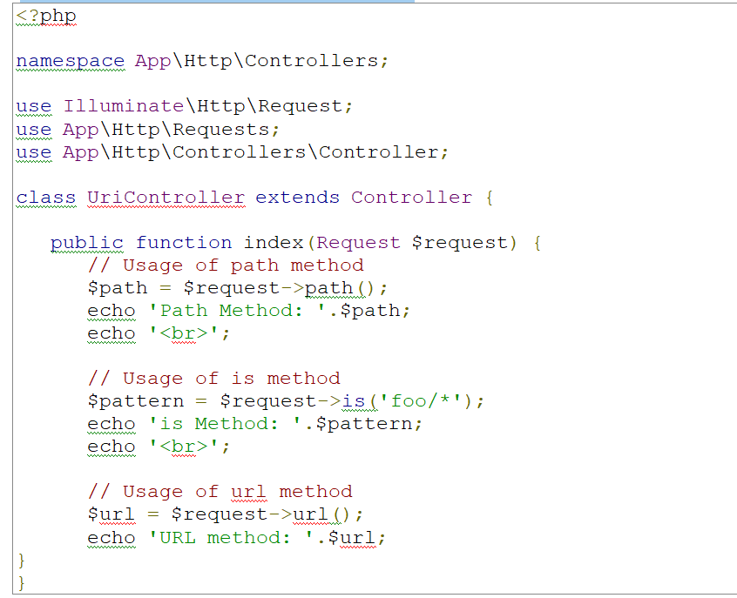

Slide 54
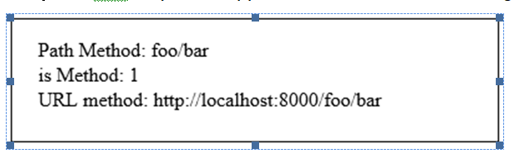
Step 4 − Add the following line in the app/Http/route.php file.
app/Http/route.php
Route::get('/foo/bar','UriController@index');
Step 5 − Visit the following URL.
http://localhost:8000/foo/bar
Step 6 − The output will appear as shown in the following image.

Slide 55
Retrieving Input
The input values can be easily retrieved in Laravel. No matter what method was used “get” or “post”, the Laravel method will retrieve input values for both the methods the same way. There are two ways we can retrieve the input values.
Using the input() method
Using the properties of Request instance

Slide 56
Using the input() method
The input() method takes one argument, the name of the field in form. For example, if the form contains username field then we can access it by the following way.
$name = $request->input('username');
Using the properties of Request instance
Like the input() method, we can get the username property directly from the request instance.
$request->username

Slide 57
Example
Observe the following example to understand more about Requests −
Step 1 − Create a Registration form, where user can register himself and store the form at resources/views/register.php

Slide 58
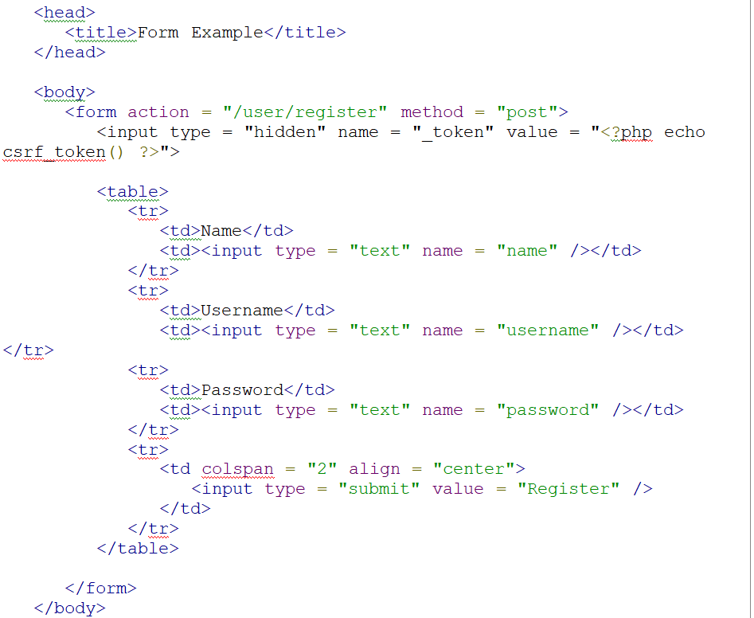

Slide 59
Step 2 − Execute the below command to create a UserRegistration controller.
php artisan make:controller UserRegistration --plain
Step 3 − After successful execution of the above step, you will receive the following output −
Step 4 − Copy the following code in
app/Http/Controllers/UserRegistration.php controller.
app/Http/Controllers/UserRegistration.php

Slide 60
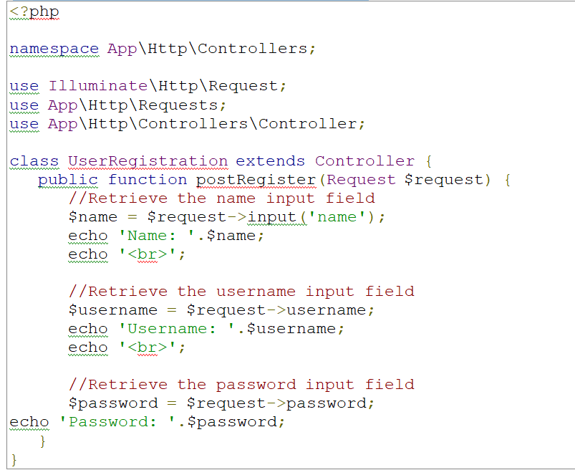

Slide 61
Step 5 − Add the following line in app/Http/routes.php file.
app/Http/routes.php
Route::get('/register',function() {
return view('register');
});
Route::post('/user/register',array('uses'=>'UserRegistration@postRegister'));

Slide 62
Step 6 − Visit the following URL and you will see the registration form as shown in the below figure. Type the registration details and click Register and you will see on the second page that we have retrieved and displayed the user registration details.
http://localhost:8000/register
Step 7 − The output will look something like as shown in below the following images.

Slide 63
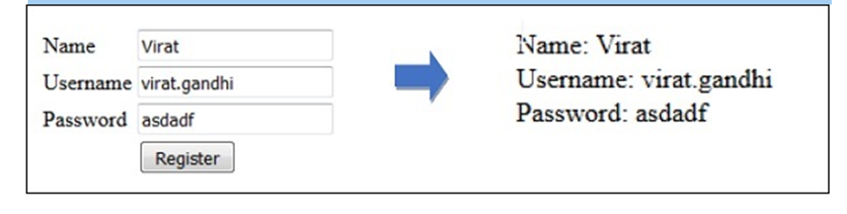

Slide 64
Laravel - Response
A web application responds to a user’s request in many ways depending on many parameters. This chapter explains you in detail about responses in Laravel web applications.
Basic Response
Laravel provides several different ways to return response. Response can be sent either from route or from controller. The basic response that can be sent is simple string as shown in the below sample code. This string will be automatically converted to appropriate HTTP response.

Slide 65
Example
Step 1 − Add the following code to app/Http/routes.php file.
app/Http/routes.php
Route::get('/basic_response', function () {
return 'Hello World';
});
Step 2 − Visit the following URL to test the basic response.
http://localhost:8000/basic_response

Slide 66
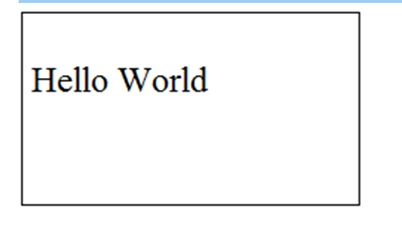
Step 3 − The output will appear as shown in the following image.

Slide 67
Attaching Cookies
The withcookie() helper method is used to attach cookies. The cookie generated with this method can be attached by calling withcookie() method with response instance. By default, all cookies generated by Laravel are encrypted and signed so that they can't be modified or read by the client.
Example
Observe the following example to understand more about attaching cookies −
Step 1 − Add the following code to app/Http/routes.php file.
app/Http/routes.php

Slide 68
Route::get('/cookie',function() {
return response("Hello", 200)->header('Content-Type', 'text/html')
->withcookie('name','Virat Gandhi');
});

Slide 69
Step 2 − Visit the following URL to test the basic response.
http://localhost:8000/cookieStep 3 − The output will appear as shown in the following image

Slide 70
JSON Response
JSON response can be sent using the json method. This method will automatically set the Content-Type header to application/json. The json method will automatically convert the array into appropriate json response.
Example
Observe the following example to understand more about JSON Response −
Step 1 − Add the following line in app/Http/routes.php file.
app/Http/routes.php

Slide 71
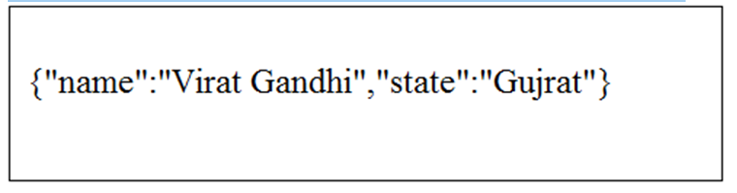
Route::get('json',function() {
return response()->json(['name' => 'Virat Gandhi', 'state' => 'Gujarat']);
});
Step 2 − Visit the following URL to test the json response.
http://localhost:8000/json
Step 3 − The output will appear as shown in the following image.

Slide 72
Laravel - Blade Templates
Laravel 5.1 introduces the concept of using Blade, a templating engine to design a unique layout. The layout thus designed can be used by other views, and includes a consistent design and structure.
When compared to other templating engines, Blade is unique in the following ways −
It does not restrict the developer from using plain PHP code in views.
The blade views thus designed, are compiled and cached until they are modified.

Slide 73
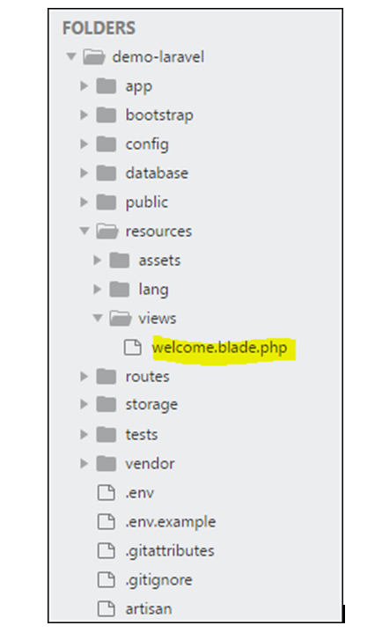

Slide 74
The complete directory structure of Laravel is shown in the screenshot given here.
You can observe that all views are stored in the resources/views directory and the default view for Laravel framework is welcome.blade.php.
Please note that other blade templates are also created similarly.

Slide 75
Steps for Creating a Blade Template Layout
You will have to use the following steps to create a blade template layout −
Step 1
Create a layout folder inside the resources/views folder. We are going to use this folder to store all layouts together.
Create a file name master.blade.php which will have the following code associated with it −

Slide 76
<html>
<head>
<title>DemoLaravel - @yield('title')</title>
</head>
<body>
@yield('content')
</body>
</html>

Slide 77
Step 2
In this step, you should extend the layout. Extending a layout involves defining the child elements. Laravel uses the Blade @extends directive for defining the child elements.
When you are extending a layout, please note the following points −
Views defined in the Blade Layout injects the container in a unique way.
Various sections of view are created as child elements.
Child elements are stored in layouts folder as child.blade.php
An example that shows extending the layout created above is shown here −

Slide 78
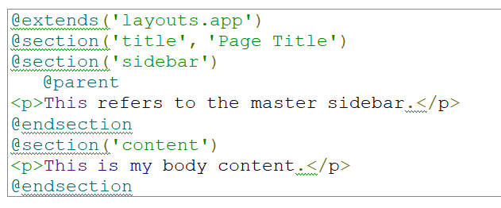

Slide 79
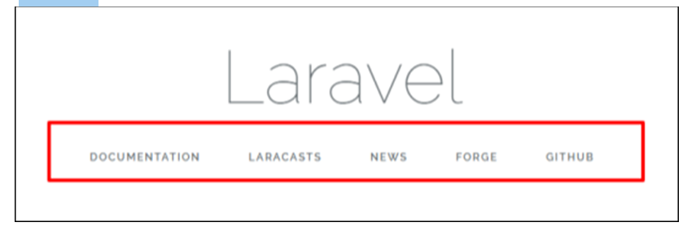
Step 3
To implement the child elements in views, you should define the layout in the way it is needed.

Slide 80
Laravel - Session
Sessions are used to store information about the user across the requests. Laravel provides various drivers like file, cookie, apc, array, Memcached, Redis, and database to handle session data. By default, file driver is used because it is lightweight. Session can be configured in the file stored at config/session.php.

Slide 81
Accessing Session Data
To access the session data, we need an instance of session which can be accessed via HTTP request. After getting the instance, we can use the get() method, which will take one argument, “key”, to get the session data.
$value = $request->session()->get('key');
You can use all() method to get all session data instead of get() method.

Slide 82
Storing Session Data
Data can be stored in session using the put() method. The put() method will take two arguments, the “key” and the “value”.
$request->session()->put('key', 'value');

Slide 83
Deleting Session Data
The forget() method is used to delete an item from the session. This method will take “key” as the argument.
$request->session()->forget('key'); Use flush() method instead of forget() method to delete all session data. Use the pull() method to retrieve data from session and delete it afterwards. The pull() method will also take key as the argument. The difference between the forget() and the pull() method is that forget() method will not return the value of the session and pull() method will return it and delete that value from session.

Slide 84
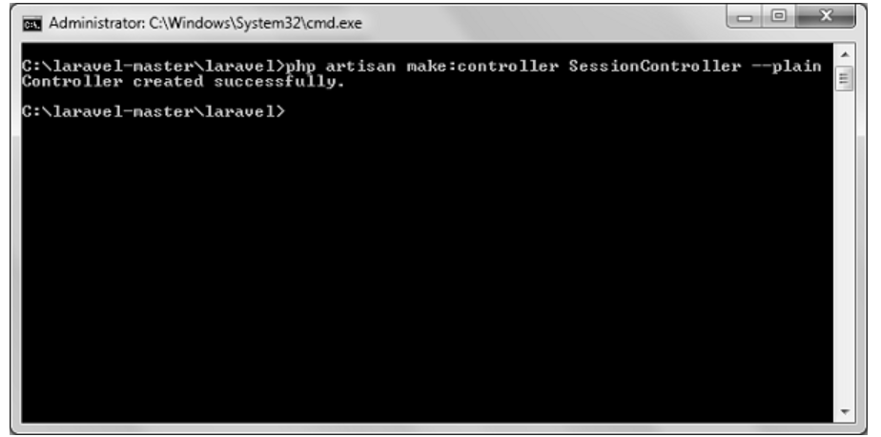
Example
Step 1 − Create a controller called SessionController by executing the following command.
php artisan make:controller SessionController --plain Step 2 − After successful execution, you will receive the following output −

Slide 85
Step 3 − Copy the following code in a file at
app/Http/Controllers/SessionController.php.
app/Http/Controllers/SessionController.php

Slide 86
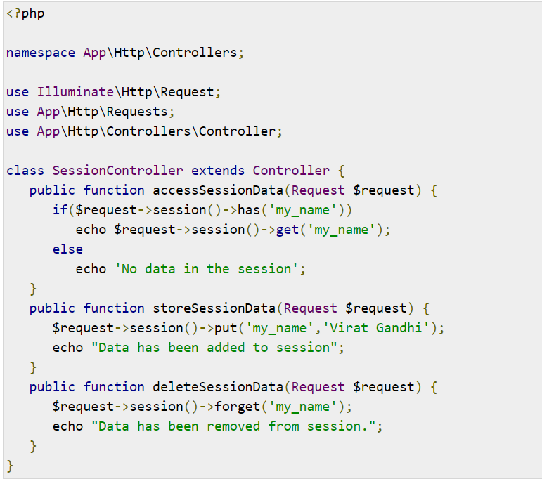

Slide 87
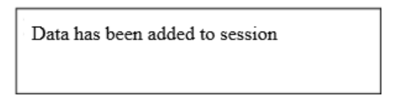
Step 4 − Add the following lines at app/Http/routes.php file.
app/Http/routes.php
Route::get('session/get','SessionController@accessSessionData'); Route::get('session/set','SessionController@storeSessionData'); Route::get('session/remove','SessionController@deleteSessionData'); Step 5 − Visit the following URL to set data in session.
http://localhost:8000/session/set Step 6 − The output will appear as shown in the following image.

Slide 88
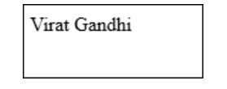
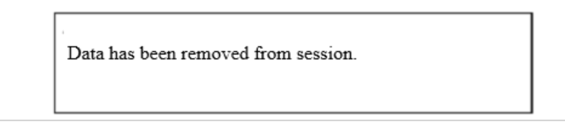
Step 7 − Visit the following URL to get data from session.
http://localhost:8000/session/get Step 8 − The output will appear as shown in the following image.
Step 9 − Visit the following URL to remove session data.
http://localhost:8000/session/remove Step 10 − You will see a message as shown in the following image.

Slide 89
Laravel - Authentication
Authentication is the process of identifying the user credentials. In web applications, authentication is managed by sessions which take the input parameters such as email or username and password, for user identification. If these parameters match, the user is said to be authenticated.
Command
Laravel uses the following command to create forms and the associated controllers to perform authentication −
php artisan make:auth

Slide 90
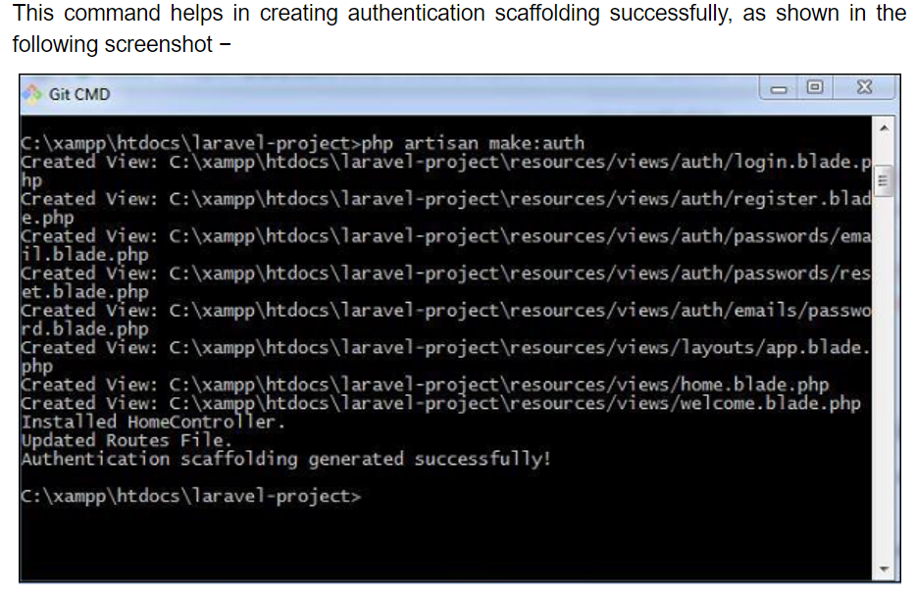

Slide 91
Controller
The controller which is used for the authentication process is HomeController.

Slide 92
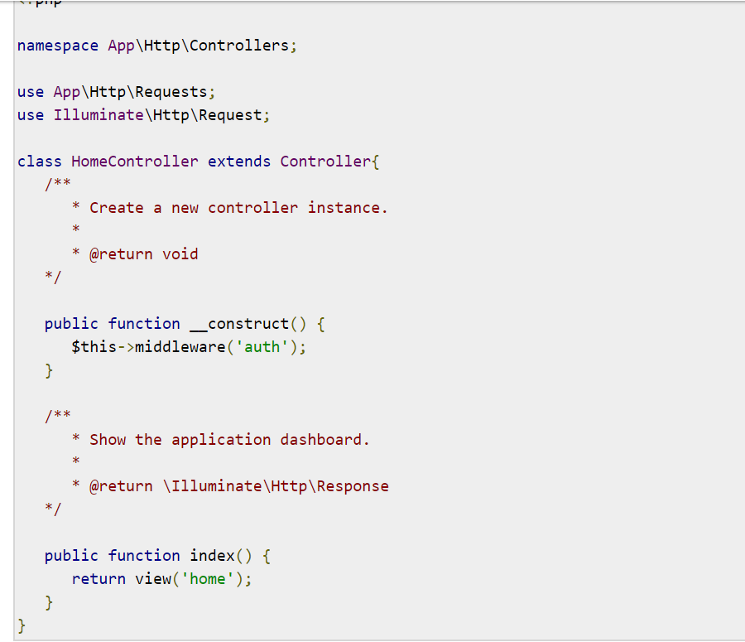

Slide 93
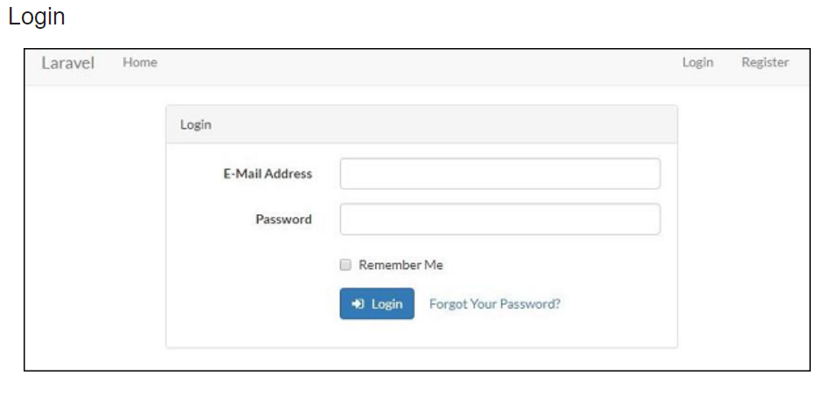
As a result, the scaffold application generated creates the login page and the registration page for performing authentication. They are as shown below −

Slide 94
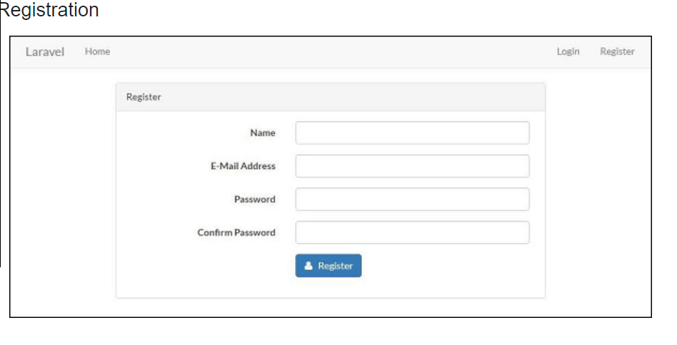

Slide 95
Manually Authenticating Users
Laravel uses the Auth façade which helps in manually authenticating the users. It includes the attempt method to verify their email and password.
Consider the following lines of code for LoginController which includes all the functions for authentication −

Slide 96
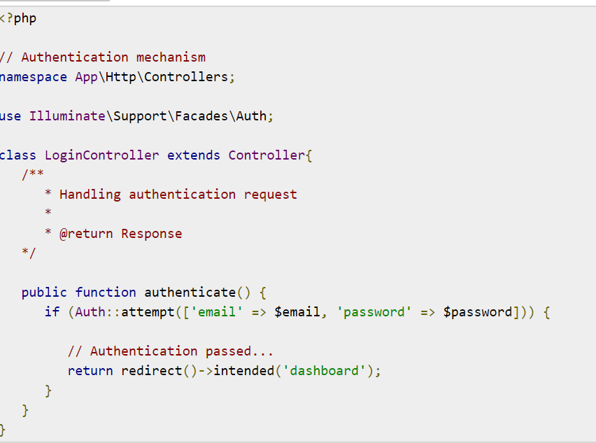

Slide 97
Laravel - Authorization
Difference between Authentication and Authorization
Before proceeding further into learning about the authorization process in Laravel, let us understand the difference between authentication and authorization.
In authentication, the system or the web application identifies its users through the credentials they provide. If it finds that the credentials are valid, they are authenticated, or else they are not.
In authorization, the system or the web application checks if the authenticated users can access the resources that they are trying to access or make a request for. In other words, it checks their rights and permissions over the requested resources. If it finds that they can access the resources, it means that they are authorized.
Thus, authentication involves checking the validity of the user credentials, and authorization involves checking the rights and permissions over the resources that an authenticated user has.

Slide 98
Authorization Mechanism in Laravel
Laravel provides a simple mechanism for authorization that contains two primary ways, namely Gates and Policies.
Writing Gates and Policies
Gates are used to determine if a user is authorized to perform a specified action. They are typically defined in App/Providers/AuthServiceProvider.php using Gate facade. Gates are also functions which are declared for performing authorization mechanism.
Policies are declared within an array and are used within classes and methods which use authorization mechanism.

Slide 99
The following lines of code explain you how to use Gates and Policies for authorizing a user in a Laravel web application. Note that in this example, the boot function is used for authorizing the users.

Slide 100
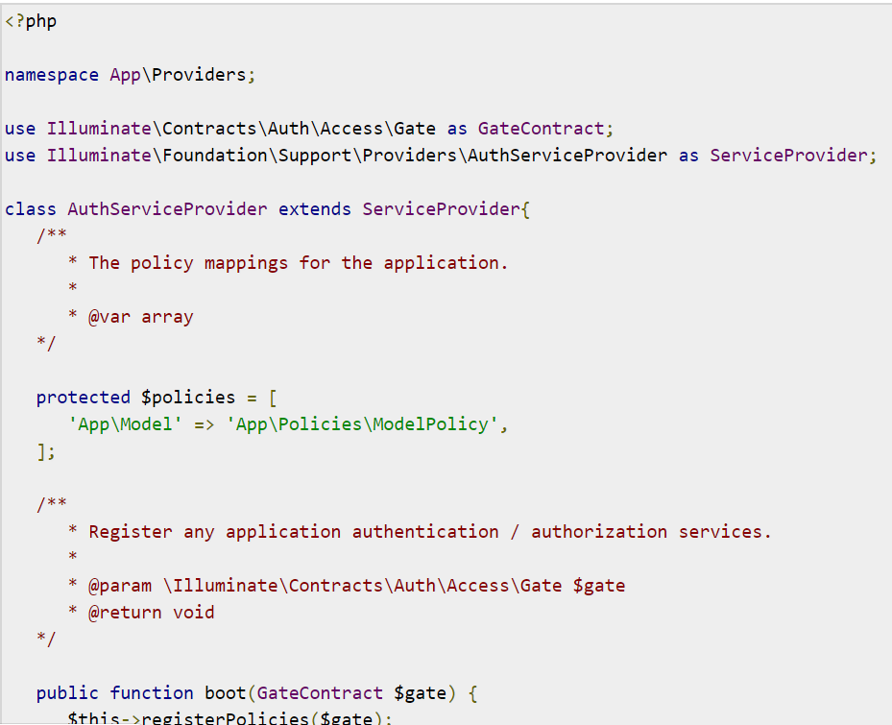

Slide 101
Laravel - Pagination Customizations
Laravel includes a feature of pagination which helps a user or a developer to include a pagination feature. Laravel paginator is integrated with the query builder and Eloquent ORM. The paginate method automatically takes care of setting the required limit and the defined offset. It accepts only one parameter to paginate i.e. the number of items to be displayed in one page.
Laravel 5.7 includes a new pagination method to customize the number of pages on each side of the paginator. The new method no longer needs a custom pagination view.
The custom pagination view code demonstration is mentioned below −

Slide 102
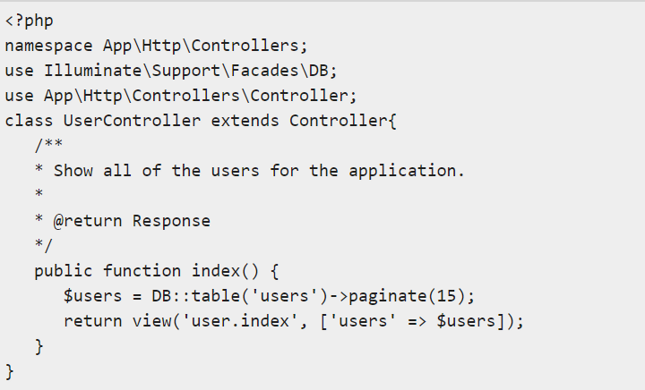

Slide 103
The new pagination customization as per Laravel standards is mentioned below −
<?php User::paginate(10)->onEachSide(5);
Note that onEachSide refers to the subdivision of each pagination records with 10 and subdivision of 5.

Slide 104
Laravel-Migration
Laravel Migrations
What is Laravel Migration?
Laravel Migration is an essential feature in Laravel that allows you to create a table in your database. It allows you to modify and share the application's database schema. You can modify the table by adding a new column or deleting an existing column.

Slide 105
Why do we need Laravel Migration?
Suppose we are working in a team, and some idea strikes that require the alteration in a table. In such a case, the SQL file needs to be passed around, and some team member has to import that file, but team member forgot to import the SQL file. In this case, the application will not work properly, to avoid such situation, Laravel Migration comes into existence.
Laravel Migration allows you to add a new column or delete the records in your database without deleting the records that are already present.

Slide 106
Make Migratoins
To make migrations
make:migrations
command is used. The general syntax of making migrations is:
php artisan make:migration message_you_want_to_remember

Slide 107
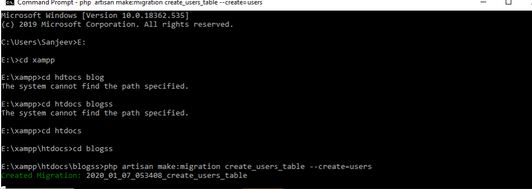
php artisan make:migration create_blogs_table --create=blogs //php artisan make:migration add_votes_to_blogs_table --table=blogs

Slide 108
Migration Structure
Migrations includes two methods inside the file: up and down. Up method helps to add the new updates to the database i.e. creating new tables or coulmns whereas down reverse the operation performed by up. To create and modify tables laravel schema builder is used, below shown the structure of a migration file:

Slide 109
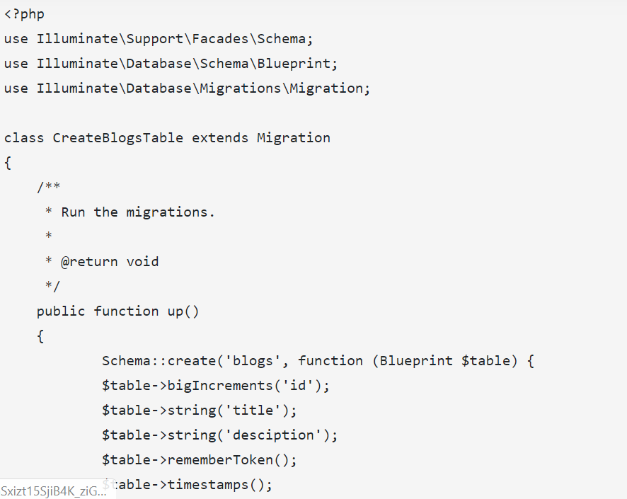

Slide 110
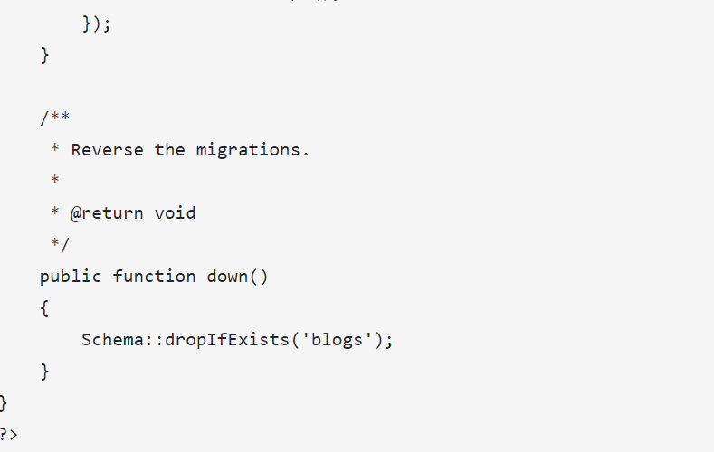

Slide 111
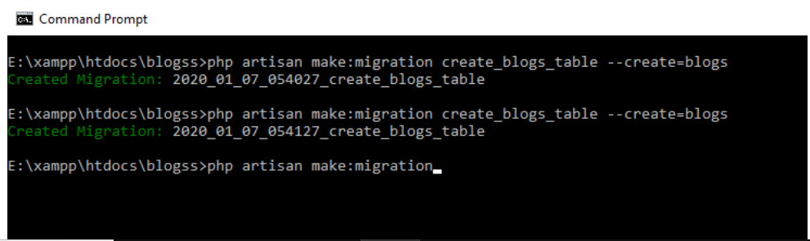
Migrations can be run by the command
php artisan make:migraion
For some destructive migrations --force flag is used to run without prompt of confirmation like so:
php artisan migrate --force

Slide 112
After Doing Migration Check Your database Blogs Table created

Slide 113
Laravel database
Laravel Databases
Database interaction in laravel is easy among all other server side scripting framework with variery of database backends either SQL, query builder or eloquent ORM.
Various DB supported by laravel are:
MySQL 5.6+
PostgreSQL 9.4+
SQLite 3.8.8+
SQL Server 2017+

Slide 114
Configuration of DB in Laravel
The directory having database connections are located inside config folder.
config/database.php
All DB connections are defined and default connections can be set. Laravel uses Laravel Homestead virtual machine for development on localmachine which can be modified according to local database.

Slide 115
SQLite Configuration:
A SQLite DB can be created with the command touch
database/database.sqlite
And can be configured by setting up by using database absolute path:
DB_CONNECTION=sqlite DB_DATABASE=/absolute/path/to/database.sqlite

Slide 116
Multiple DB Connections:
Laravel supports multiple database connections and handle easily with connection() method on DB facade. Connections can be accessed in such a way as shown below:
$users = DB::connection('DIFF_DB')->select(...);
Make sure the name passed in connection method should correspond to connection listed in config/database.php file. PDO instance can also be used on the connection instance by syntax shown below by using getPdo() method:
$pdo = DB::connection()->getPdo();

Slide 117
Running RAW SQL Queries
After DB configuration you may simply run queries as used in php using DB facade which provides method for each type of query: select, insert, update, delete and other statements. Below shown example and screenshot of the select query and other queries will work in the same manner.
Make UserController.php file and paste the following code:

Slide 118
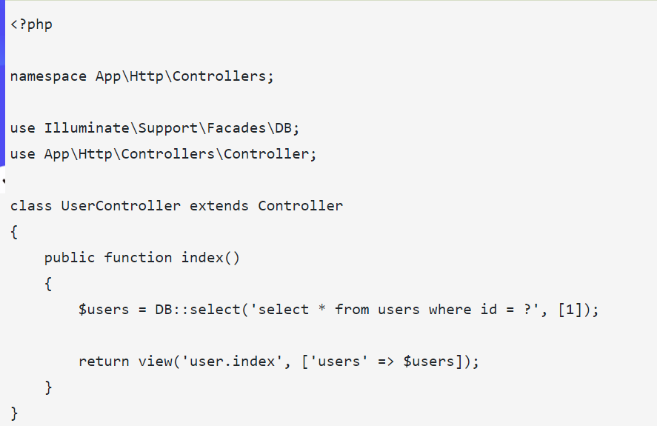

Slide 119
n web.php file add code metioned below:
Route::get('/database','UserController@index');
You must create a users DB in your phpmyadminpannel.
Above query the select() method consist of two parameters: select query and other is parameter binding that is to be bound with query. Instead of using ? in above query named binding can be used as shown below:
$results = DB::select('select * from users where id = :id', ['id' => 1]);

Slide 120
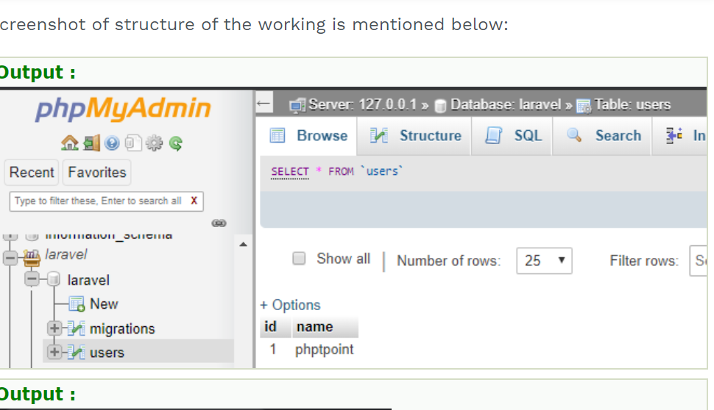
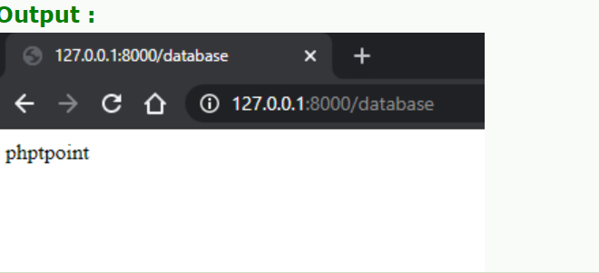

Slide 121
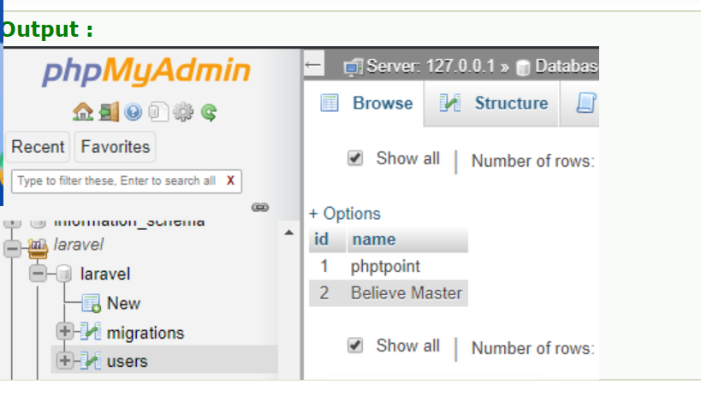
Insert Query:
DB::insert('insert into users (id, name) values (?, ?)', [2, 'Believ Master']);

Slide 122
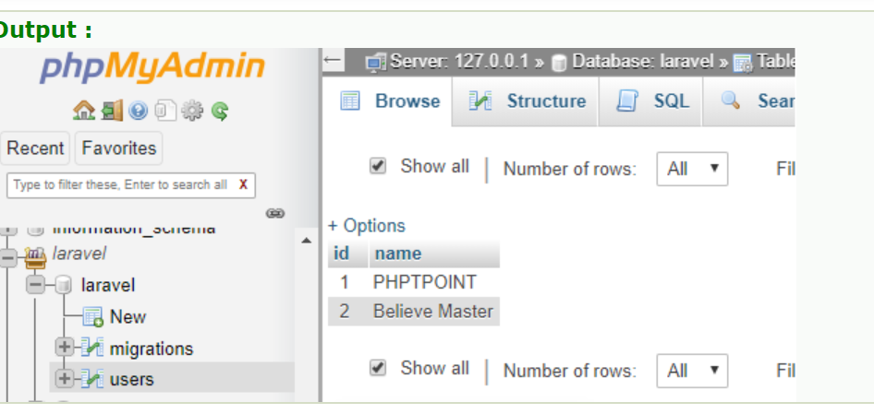
Update Query:
$update = DB::update("update users set name = 'PHPTPOINT' where id = ?", [1]);

Slide 123
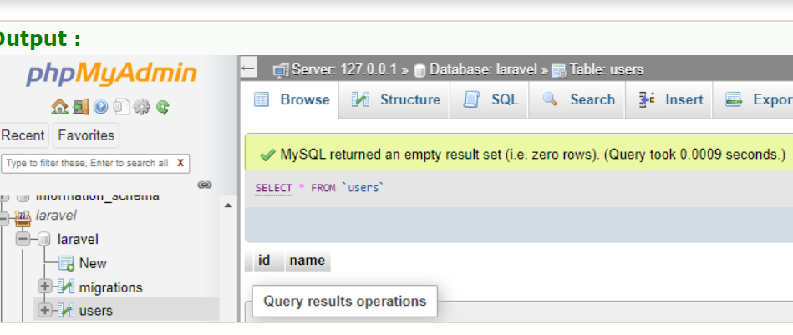
Delete Query:
$delete = DB::delete('delete from users');

Slide 124
Drop Query:
DB::statement('drop table users');

